Slide 1

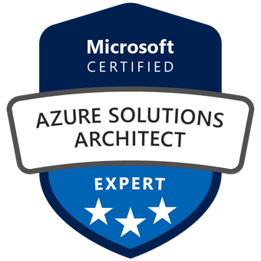


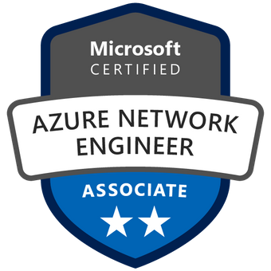

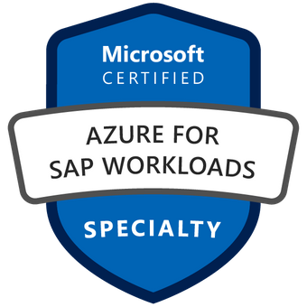
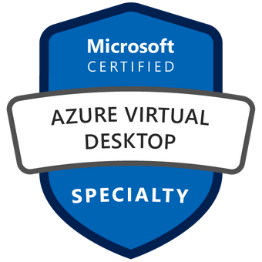
RoboMate Cloud Automation
Developed By : Marco Fekry

Slide 2

Agenda
What is RoboMate?
RoboMate Assessments
RoboMate Automation
RoboMate Tools
Success Stories

Slide 3
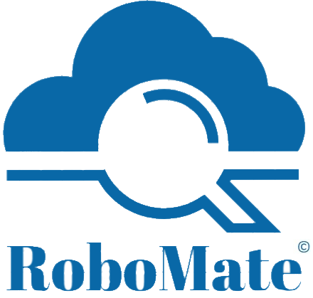
What is RoboMate?

Slide 4
What is RoboMate?
RoboMate is a cloud automation desktop tool which integrates multiple code languages through a powerful UI providing streamline deployments to Azure in just a few clicks.
RoboMate has been designed to assess Azure environments in terms of Azure Resources, Azure Security , Identity , Charts and Cost.
RoboMate customized deployment scenarios, offering a lot of deployment options using Azure Well Architect Framework and Microsoft Cybersecurity reference architecture.

Slide 5




RoboMate Benefits
Deploy ,update and manage production environments in a few clicks
RoboMate converts Hard working hours to minutes
RoboMate efficiency eliminates human errors in deploying resources
RoboMate minimizes administrative efforts
RoboMate streamline deployments captured from real production customers environment use cases
RoboMate automations are interactive with the user making it easy to select your requirements

Slide 6
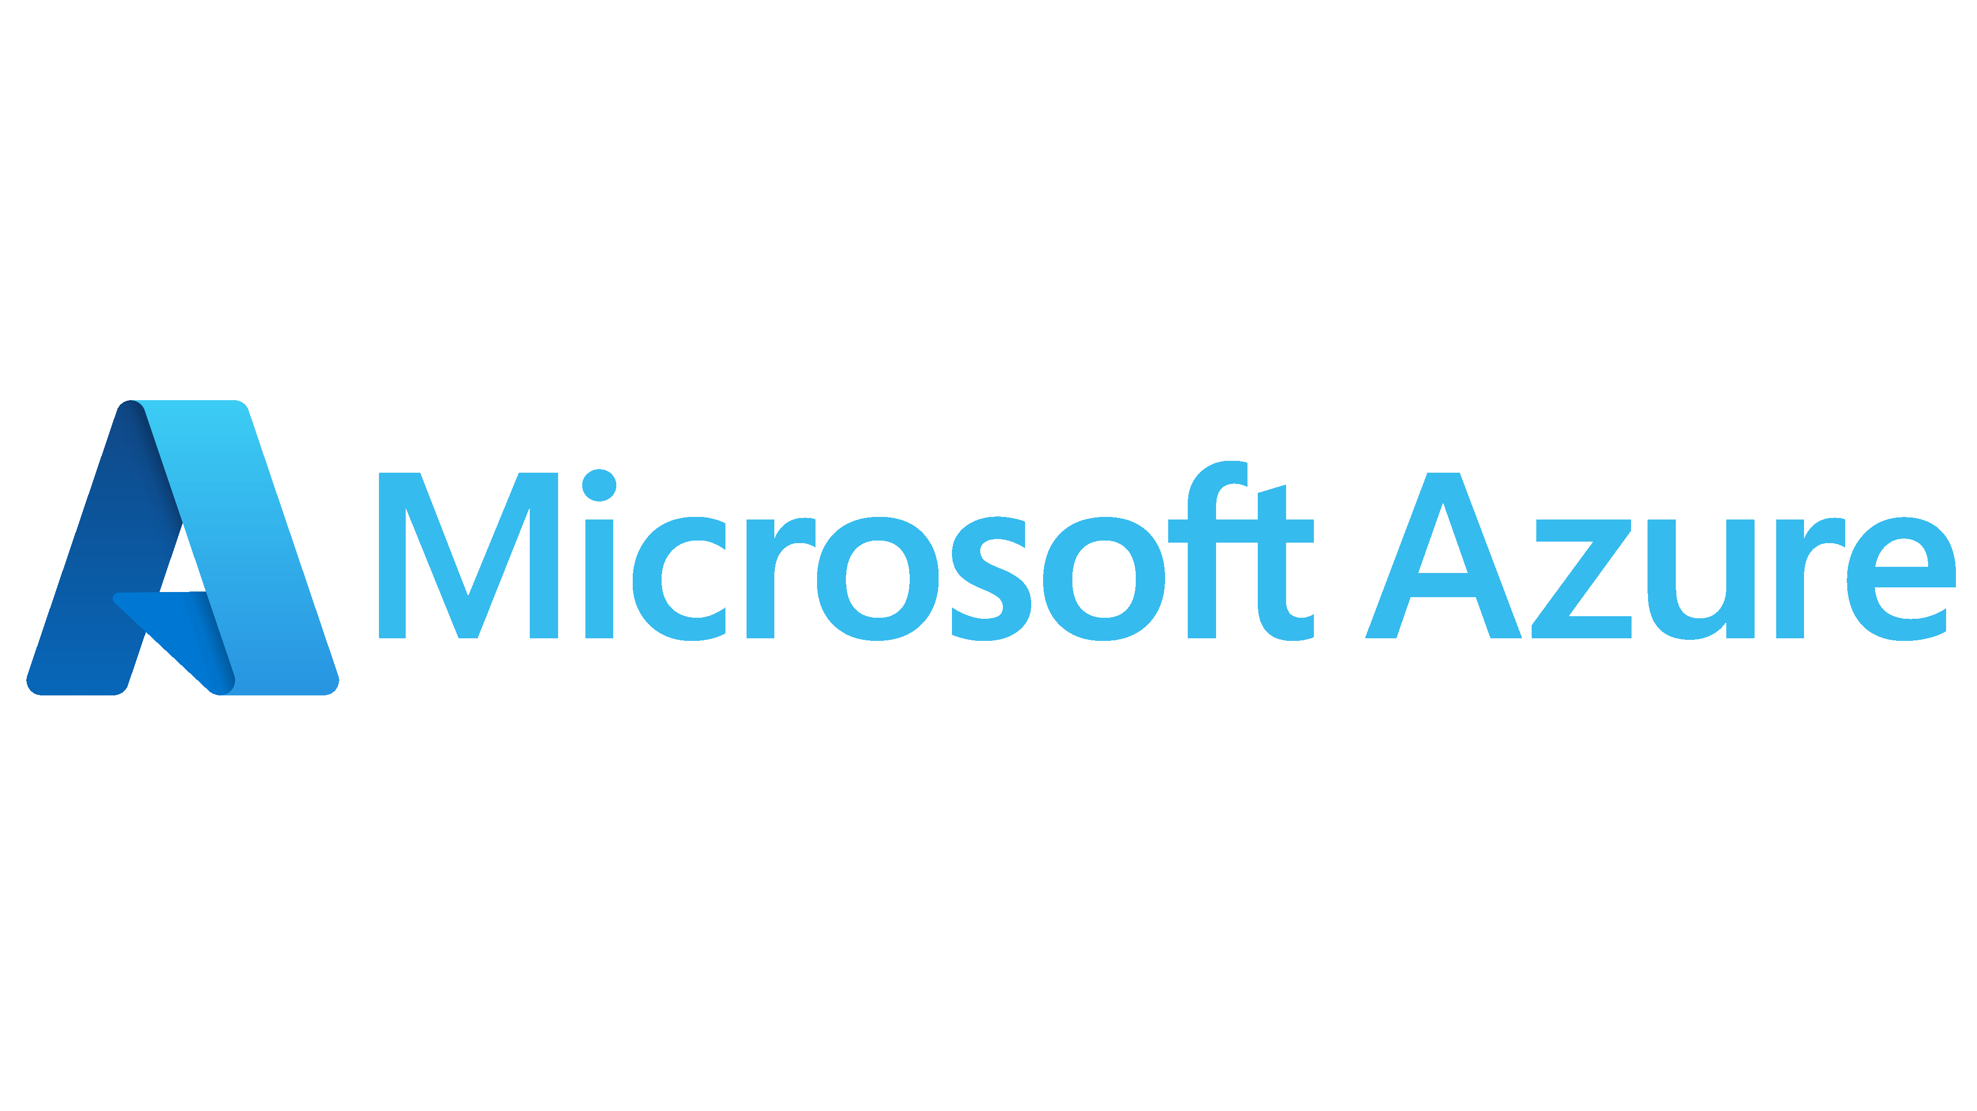
RoboMate’s Assessment Offerings:
Environment & Resources Assessment
Identity & Security Assessment
Environment Charts Analysis
Cost Analysis
Notes:
To highlight a few points on this slide:
As I’ve mentioned before, we are global. We support 60+ Azure regions around the world.
We what you to feel protected so we heavily invest in security.
Lastly, we have 93 compliance offerings from certifications to laws we abide by, like GDPR.

Slide 7

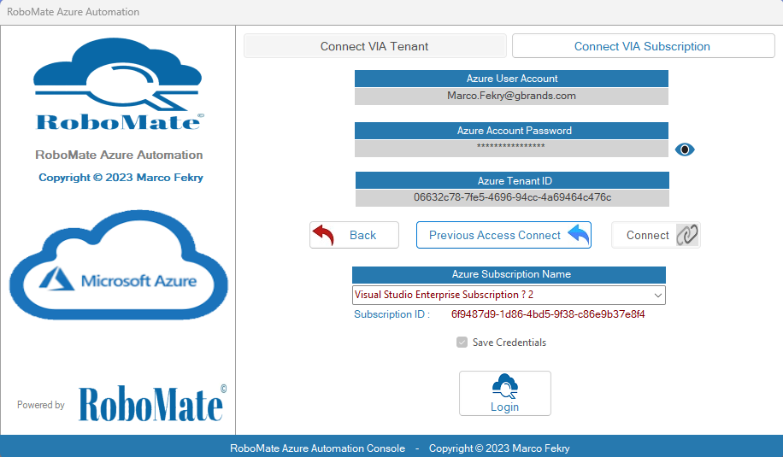
RoboMate Azure Assessment
Log in
You can sign into your Azure Environment using your account credentials , Subscription ID or a Tenant ID

Slide 8
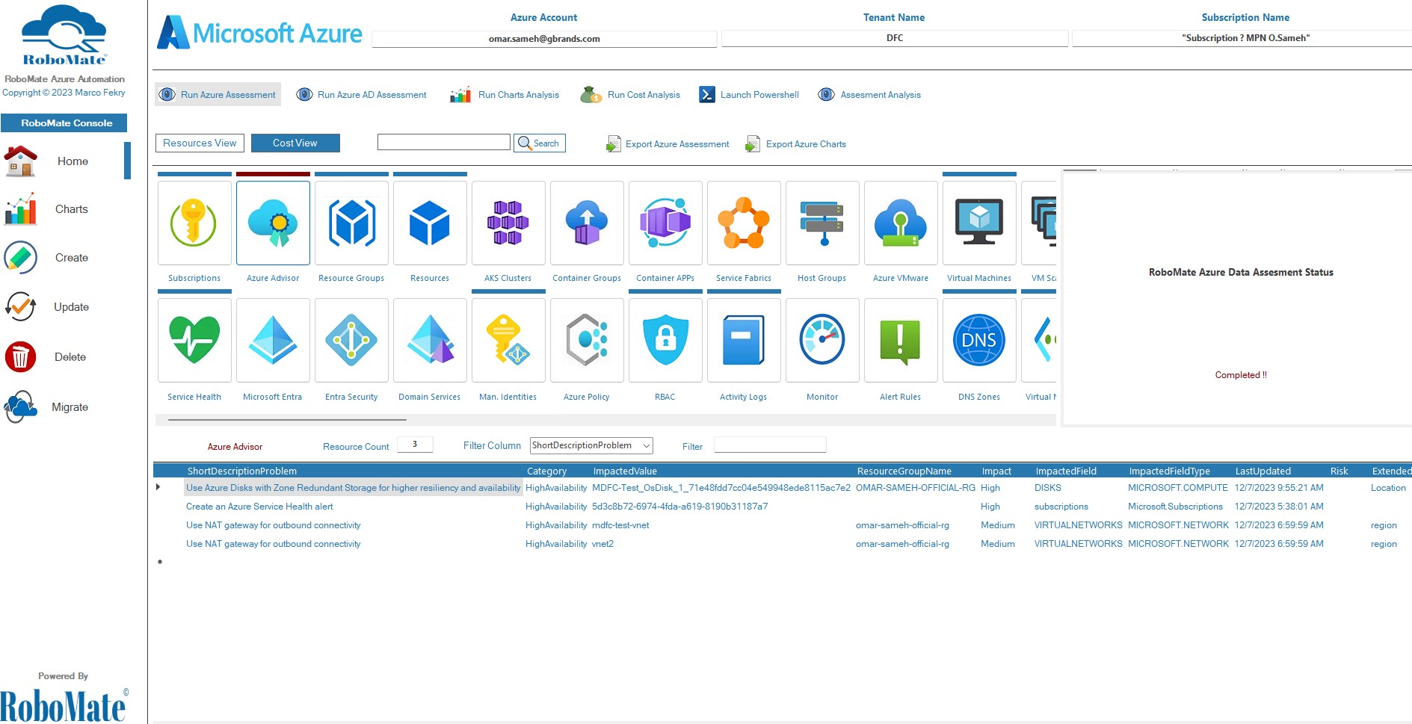
RoboMate Azure Assessment
You can see the status of run Azure discovery from here
See the result of Azure Assessments
Notes:
To highlight a few points on this slide:
As I’ve mentioned before, we are global. We support 60+ Azure regions around the world.
We what you to feel protected so we heavily invest in security.
Lastly, we have 93 compliance offerings from certifications to laws we abide by, like GDPR.

Slide 9
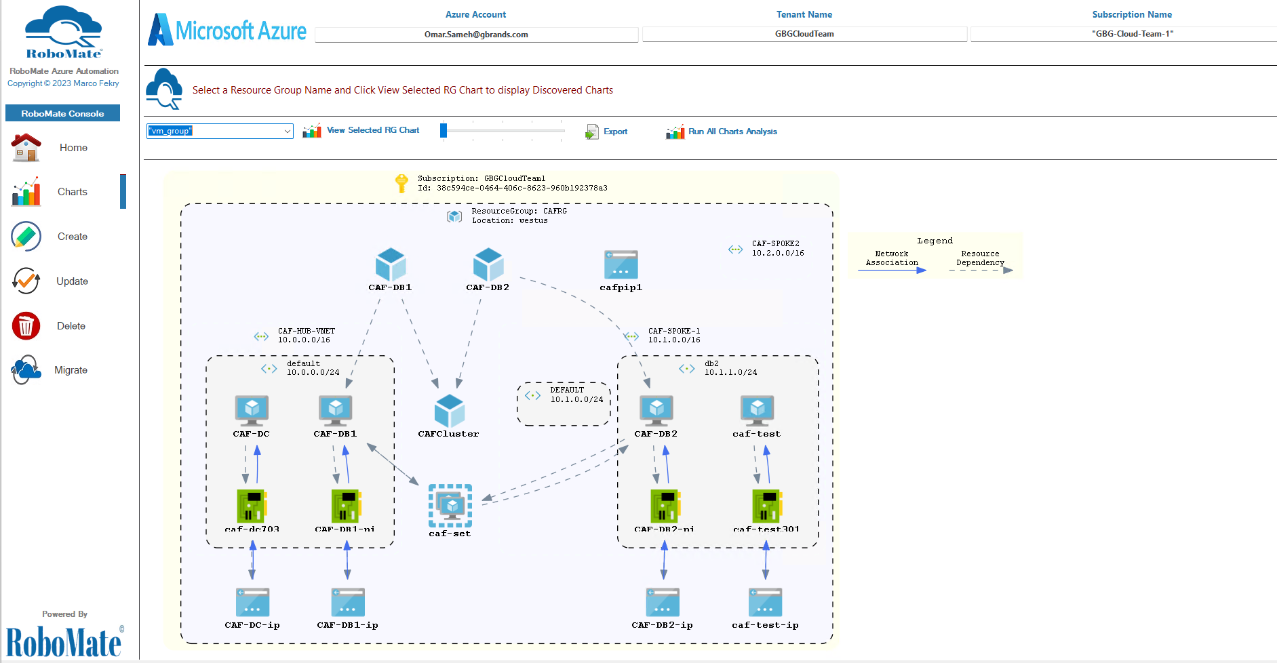
RoboMate Azure Assessment
You can view the charts from here
Notes:
To highlight a few points on this slide:
As I’ve mentioned before, we are global. We support 60+ Azure regions around the world.
We what you to feel protected so we heavily invest in security.
Lastly, we have 93 compliance offerings from certifications to laws we abide by, like GDPR.

Slide 10
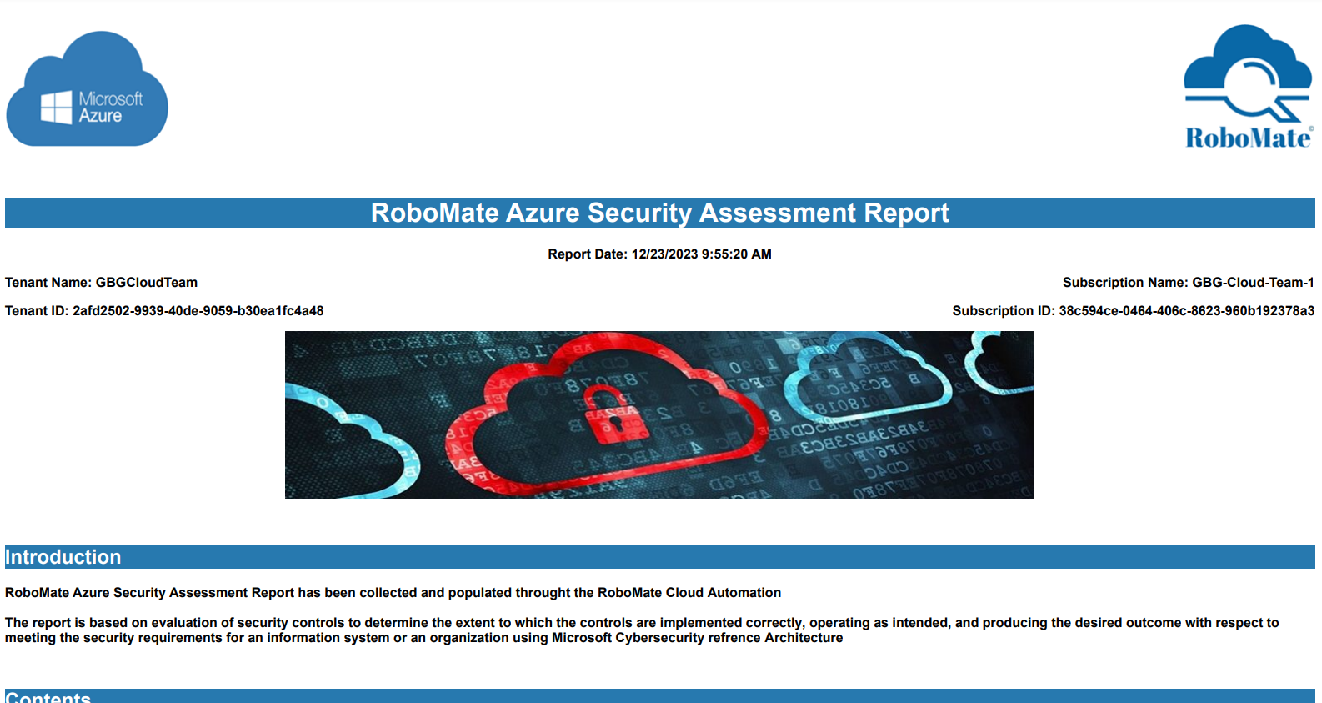
RoboMate Azure Security Assessment Report
Notes:
To highlight a few points on this slide:
As I’ve mentioned before, we are global. We support 60+ Azure regions around the world.
We what you to feel protected so we heavily invest in security.
Lastly, we have 93 compliance offerings from certifications to laws we abide by, like GDPR.

Slide 11



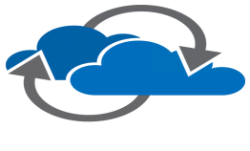
RoboMate Automation Offerings
Create
Update
Delete
Migrate

Slide 12
Create

Slide 13







RoboMate Creation Deployments
Landing Zone
Scaled Hub and Spoke Landscape (Azure Firewall)
Scaled Hub and Spoke Landscape (Palo Alto VMSeries-Flex)
Scaled Hub and Spoke Landscape (FortiGate VM)
Scaled Hub and Spoke Landscape (FortiGate HA Active-Active)
Scaled Hub and Spoke Landscape (FortiGate HA Active-Passive)
Scaled Hub and Spoke Landscape (Sonic Wall NSV)
Scaled Hub and Spoke Landscape (Double Firewall)
SAP
SAP APP Virtual Machines
SAP HANA Virtual Machines
SAP Customized Virtual Machine
SAP ASCS / ERS / PAS SUSE PaceMaker Cluster
SAP HANA DB SUSE PaceMaker Cluster(Best Practice)
SAP HANA DB SUSE PaceMaker Cluster Customized)
SQL
File Share
Azure Premium File Share NFS for Linux
Azure Standard File Share SMB for Windows
Azure Standard File Share SMB for Linux
SQL Customized Standalone VMs
SQL Always On Availability Group
Azure Labs
AVD
Automation
Azure Virtual Desktop with FSlogix
Create User Managed Identity Automation Runbooks
Azure Labs

Slide 14

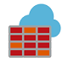




RoboMate Creation Deployments
Create Windows Server Active Directory VM
Create Windows Server SQL VM
Create Windows Server File Server VM
Create Windows Hyper-V Nested Virtualization VM
Create Windows Server IIS Server VM
Create Windows/Linux Docker Virtual Machines in an existing VNet
Create Windows Bulk Virtual Machines in an existing VNet
Create SUSE Bulk Virtual Machines in an existing VNet
Create Canonical Bulk Virtual Machines in an existing VNet
Create Open logic Bulk Virtual Machines in an exist VNet
Azure Firewall
Virtual Machines
Deploy Azure Firewall with default Rules
VPN
AKS & Containers
Create Azure VPN Gateway P2S
Create Customized AKS Cluster with ACR
Create Customized Containers with Docker
Virtual Network
VMSS
Create Spokes VNETs with their dependencies
Create Azure Customized Scale Set

Slide 15





RoboMate Creation Deployments
Sentinel
Front Door &
App Gateway
Create Front door with Regional App Services
Create Default Application Gateway & WAF
Deploy Microsoft Sentinel
Workbooks
Policy
Create and Deploy RoboMate Azure Workbooks
Deploy Azure Policy (Defender/Benchmarks/Monitor/AHB/Controls)
Backups and DR
Configure Backups for VMs
Export VMs Disks
Deploy ASR DR

Slide 16
Update

Slide 17



RoboMate Update Deployments
Virtual Machines
SAP APP Virtual Machine
SAP HANA Virtual Machine
SAP ASCS / ERS / PAS SUSE PaceMaker Cluster
SAP HANA DB SUSE PaceMaker Cluster
Configure Windows Server VM as Domain Controller
Update an Existing Windows Server Virtual Machine
Join Virtual Machine to AD/AZ AD
Deploy Virtual Machine Azure SQL Extension
Bulk Update for Windows/Linux VMs License/Disks/Roles
SAP
Azure Monitor
Security
Azure Security and Monitoring Deployment
Azure Policy (Defender/Benchmarks/Monitor/AHB/Controls)
Azure VMs OS Updates Patching with Automation Account
Configure Defender for Cloud
Configure DDOS Protection
Configure Sentinel Workspace
Azure Monitor for Virtual Machines
Azure Monitor Alerts for Virtual Machines
Azure
Firewall
App Gateway
Start Azure Firewall
Stop Azure Firewall
Update AZ Firewall with DC and Default Rules
Start Azure APP Gateway
Stop Azure App Gateway

Slide 18



RoboMate Update Deployments
Container Registry
Backups
Register Bulk Virtual Machines to Azure Backup
Update existing ACR with Docker Images
File Share
Azure File Share NFS for Linux
NSG
Configure Azure Domain Controller NSG Rules
Subscription
Register Subscription Resource Providers

Slide 19
Migrate

Slide 20

RoboMate Migrate Deployments
Virtual Network
Virtual Machines
Migrate virtual machine to another Virtual Network
Migrate virtual machines to another Subscription/Region
Migrate virtual machines to another Subscription within Same Region
Clone Virtual Networks to another Region
Azure Firewall
Application
Gateway
Migrate Azure firewall to another region
Upgrade or Downgrade SKU
Migrate Application Gateway to another VNet
Migrate application gateway to another region
Resources
Migrate AZ Resources from one RG to another RG
Migrate AZ Resources from one RG/Sub to another RG/Sub

Slide 21
Delete

Slide 22


RoboMate Delete Deployments
Backups & RSVs
Resource
Groups
Remove Azure Backups for Virtual Machines
Delete a Recovery Vault
Delete Bulk Azure Resource Groups
Azure Resources
VMSS
Virtual Network
Delete Bulk Azure Virtual Machines Scale Sets
Azure Bulk Virtual Networks Delete Automation
Delete Bulk Azure Resources
Virtual Machines
Policy
Delete Bulk Azure Virtual Machines
Azure Policy Deletion Action

Slide 23
RoboMate Deployment Simulation
Follow these steps to create the environment :
1- Choose an Azure resources which you need to create.
1
2- Choose your required scenario.
2
3- Press configure Parameters to start.
3
4- Fill up the required parameters.
4
5- Then press create to create your environment.
5
What is ROBOMATE?

Slide 24
RoboMate Home Page
Main console
Select Action
Notes:
To highlight a few points on this slide:
As I’ve mentioned before, we are global. We support 60+ Azure regions around the world.
We what you to feel protected so we heavily invest in security.
Lastly, we have 93 compliance offerings from certifications to laws we abide by, like GDPR.

Slide 25
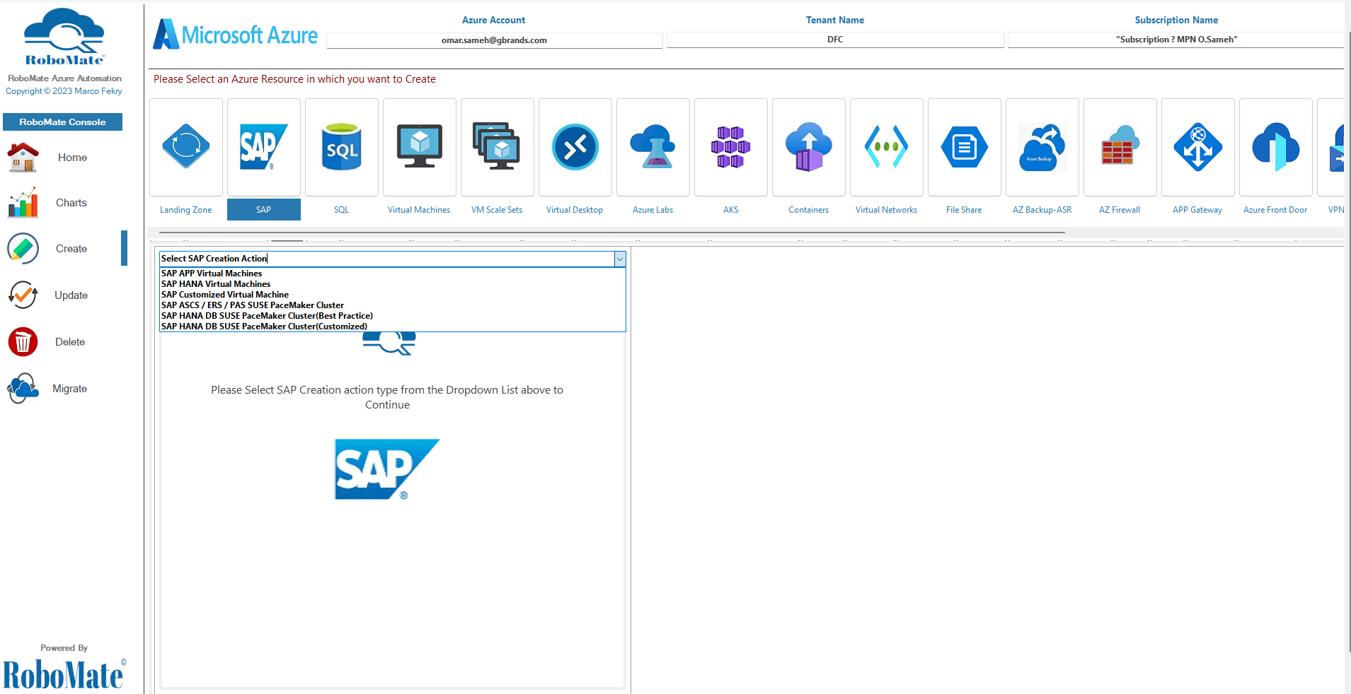
Start your Deployment
Then Select your Deployment type
Select Deployment Component
Notes:
To highlight a few points on this slide:
As I’ve mentioned before, we are global. We support 60+ Azure regions around the world.
We what you to feel protected so we heavily invest in security.
Lastly, we have 93 compliance offerings from certifications to laws we abide by, like GDPR.

Slide 26
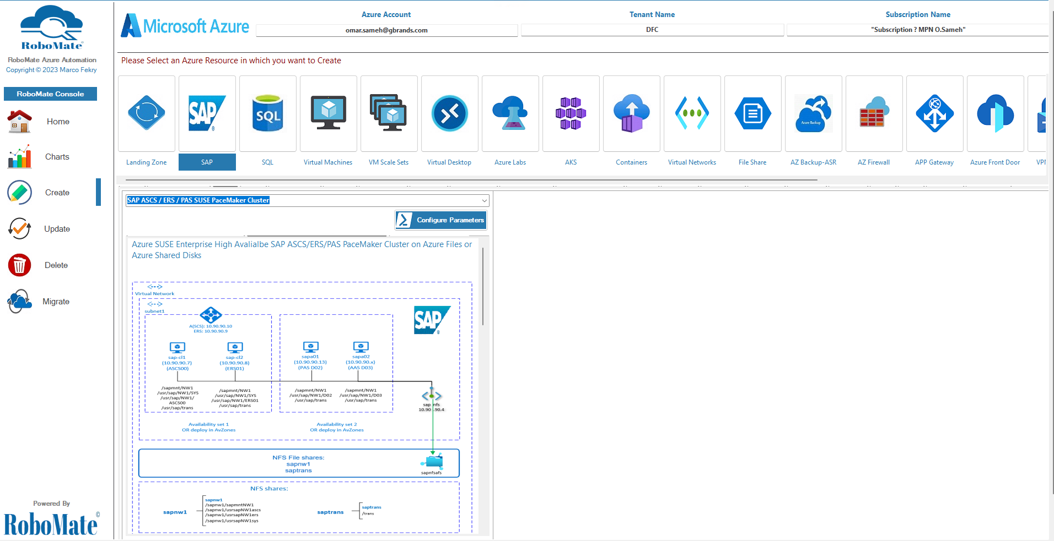
Create your Deployment
ROBOMATE steps to start SAP HANA DB SUSE PaceMaker Cluster Deployment
1
Press configure parameters to start
You will see description of your scenario
chart and the steps .
Notes:
To highlight a few points on this slide:
As I’ve mentioned before, we are global. We support 60+ Azure regions around the world.
We what you to feel protected so we heavily invest in security.
Lastly, we have 93 compliance offerings from certifications to laws we abide by, like GDPR.

Slide 27
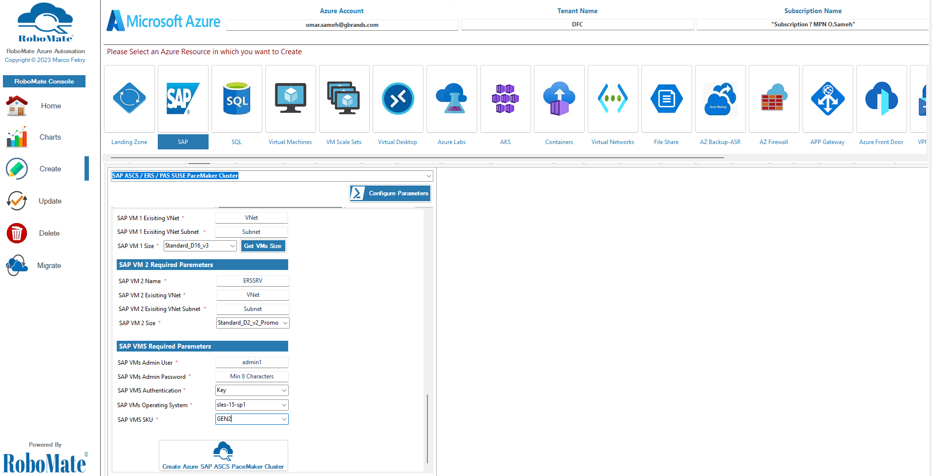
Create your Deployment
ROBOMATE is ready to go now after filling up all the required parameters
1
Fill up the required parameters
Press Create to create your Environment
Notes:
To highlight a few points on this slide:
As I’ve mentioned before, we are global. We support 60+ Azure regions around the world.
We what you to feel protected so we heavily invest in security.
Lastly, we have 93 compliance offerings from certifications to laws we abide by, like GDPR.

Slide 28
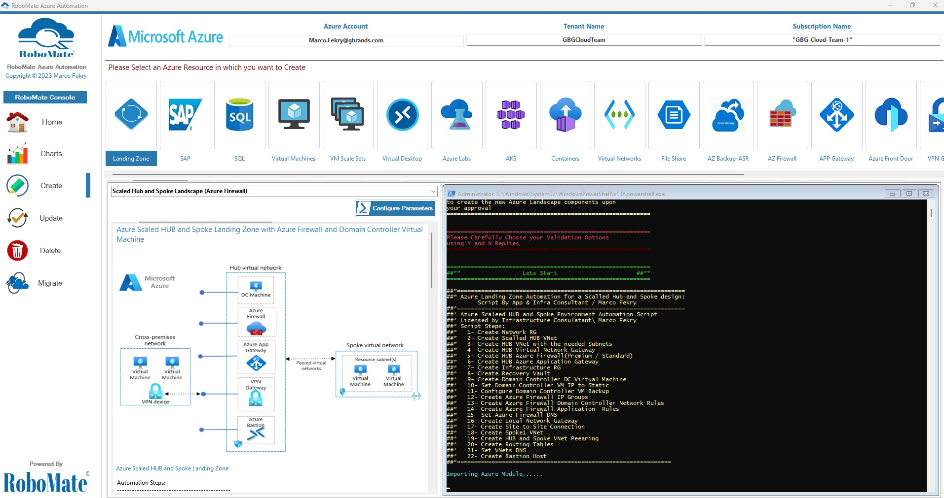
RoboMate Creation Deployments
Hub and Spoke Landing Zone with Azure Firewall
Notes:
To highlight a few points on this slide:
As I’ve mentioned before, we are global. We support 60+ Azure regions around the world.
We what you to feel protected so we heavily invest in security.
Lastly, we have 93 compliance offerings from certifications to laws we abide by, like GDPR.

Slide 29
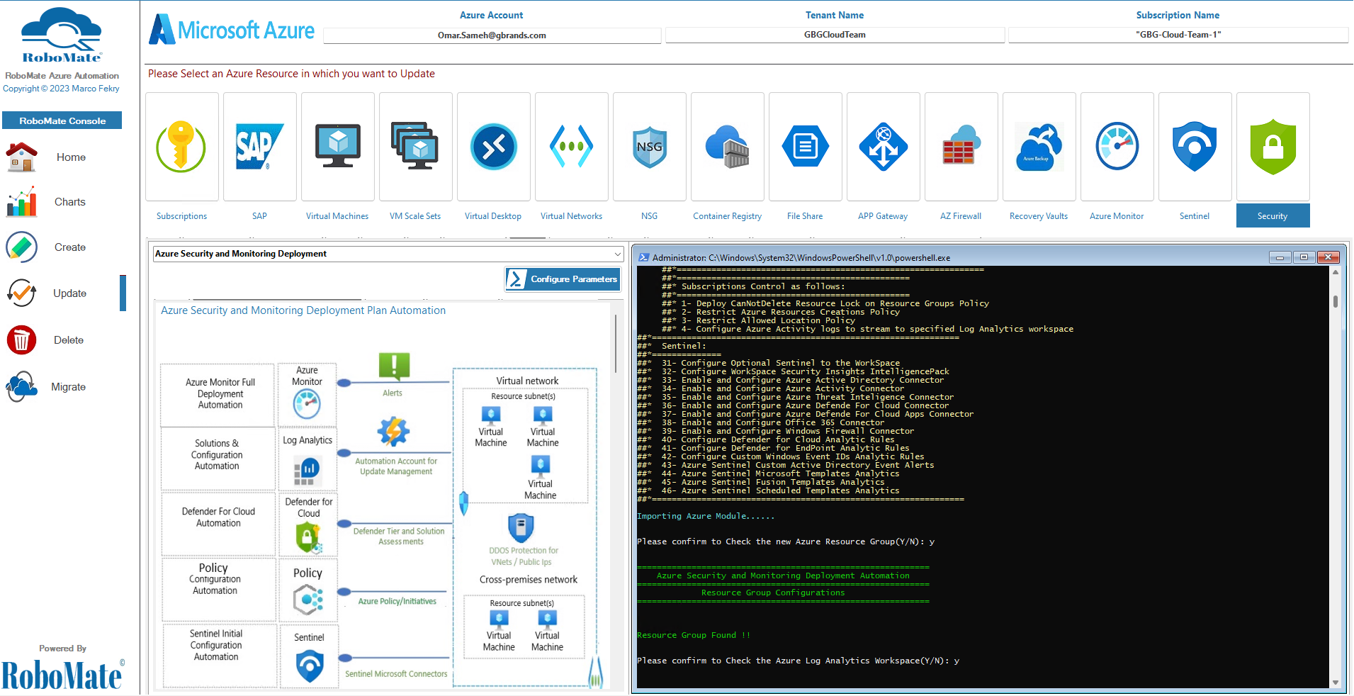
RoboMate Update Deployment
Azure Full Security and Monitoring Deployment
Notes:
To highlight a few points on this slide:
As I’ve mentioned before, we are global. We support 60+ Azure regions around the world.
We what you to feel protected so we heavily invest in security.
Lastly, we have 93 compliance offerings from certifications to laws we abide by, like GDPR.

Slide 30
RoboMate Tools

Slide 31
RoboMate Administration Tools
RoboMate has a powerful built in tools which you can use easily
Internet speed: Measures the speed of your internet.
Geolocation Finder: Easily find the location by IP address.
DNS Lookup: Run DNS lookup resource.
SSL: Has a powerful ability to convert and export certificates to any format & create a self signed certificate
Trace Route: Figuring out the routing hops as well as response delays as it travels across nodes.
Notes:
To highlight a few points on this slide:
As I’ve mentioned before, we are global. We support 60+ Azure regions around the world.
We what you to feel protected so we heavily invest in security.
Lastly, we have 93 compliance offerings from certifications to laws we abide by, like GDPR.

Slide 32
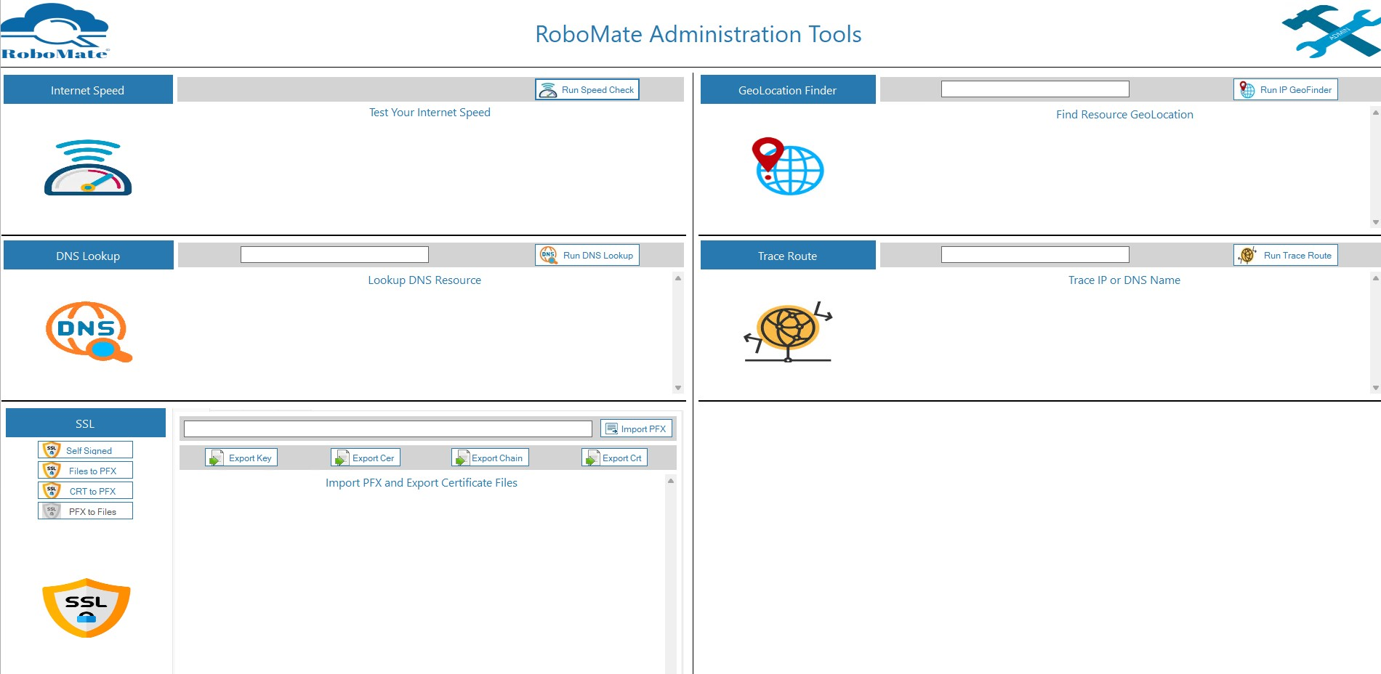
RoboMate Tools
Administration tools
Notes:
To highlight a few points on this slide:
As I’ve mentioned before, we are global. We support 60+ Azure regions around the world.
We what you to feel protected so we heavily invest in security.
Lastly, we have 93 compliance offerings from certifications to laws we abide by, like GDPR.

Slide 33
Success Stories

Slide 34

RoboMate Cloud Automation
Thank You

